Slide 1



Internship on “Chronic Disease Prediction” Subject Code : 21CSI68
Rupam Bhattacharyya (1EP21CS089)
Under the Guidance of
Prof. Pavan Kumar R B,
Assistant Professor,
Department of CSE, EPCET

Slide 2
Contents
Introduction
About the Company
Aim
Literature Survey
Internship Timeline
Technical Skills Gained
Tools
Hardware and Software Requirements
Flow Diagrams
Internship Implementation
Learning Outcome
Outcome Analysis
Challenges Faced
References

Slide 3
Introduction
Chronic disease prediction using Python leverages machine learning and data science techniques to anticipate the onset or progression of long-term health conditions such as diabetes, heart disease, and chronic respiratory diseases. By analyzing large datasets that include patient history, lifestyle factors, genetic information, and clinical test results, Python's powerful libraries—such as scikit-learn, TensorFlow, and pandas—enable the development of predictive models.
The core idea behind machine learning is to enable computers to recognize patterns, correlations, and trends within datasets, ultimately allowing them to make predictions or decisions based on this acquired knowledge.

Slide 4
Supervised Learning
In this approach, the algorithm is trained on a labeled dataset, where the input data is paired with corresponding output labels. The model learns to map inputs to outputs, making predictions on new, unseen data. Common applications include image recognition, speech recognition, and predictive modeling.
Unsupervised Learning
Unlike supervised learning, unsupervised learning deals with unlabeled data. The algorithm explores the data's inherent structure and relationships, identifying patterns and grouping similar data points. Clustering and dimensionality reduction are common tasks within unsupervised learning, applicable in fields like customer segmentation and anomaly detection.
Reinforcement Learning
This learning paradigm involves an agent learning to make decisions by interacting with an environment. The agent receives feedback in the form of rewards or penalties based on its actions, allowing it to learn optimal strategies over time. Reinforcement learning is widely used in areas such as game playing, robotics, and autonomous systems.

Slide 5
About Varcons Technologies
Location: Bangalore, India
Started Year: 2010
Founder Names: Rajesh Kumar, Anitha Reddy
Service Offerings:
Software Development: Custom software solutions for various industries.
IT Consulting: Providing expert advice on IT infrastructure and strategy.
Training Programs: Offering courses in Data Science, Machine Learning, and Artificial Intelligence.

Slide 6
Objectives of the Internship
Data Preprocessing and Feature Selection: To understand and implement techniques for cleaning and preparing data for machine learning models.
Model Training and Optimization: To train the Naive Bayes algorithm on the dataset and optimize its performance for accurate disease prediction.
Evaluation and Validation: To evaluate the model's performance using various metrics such as accuracy, precision, and recall, and validate its effectiveness with real-world data.
Application Development: To develop a user-friendly application that utilizes the trained Naive Bayes model for predicting chronic diseases based on user inputs.

Slide 7
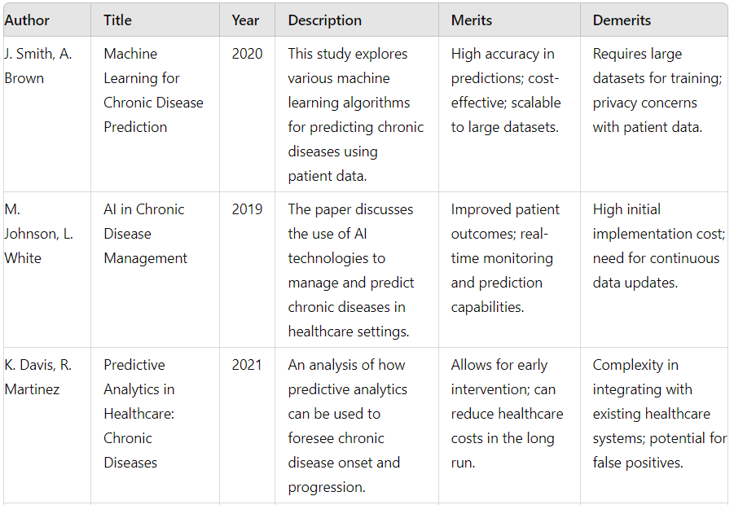
Literature Survey

Slide 8
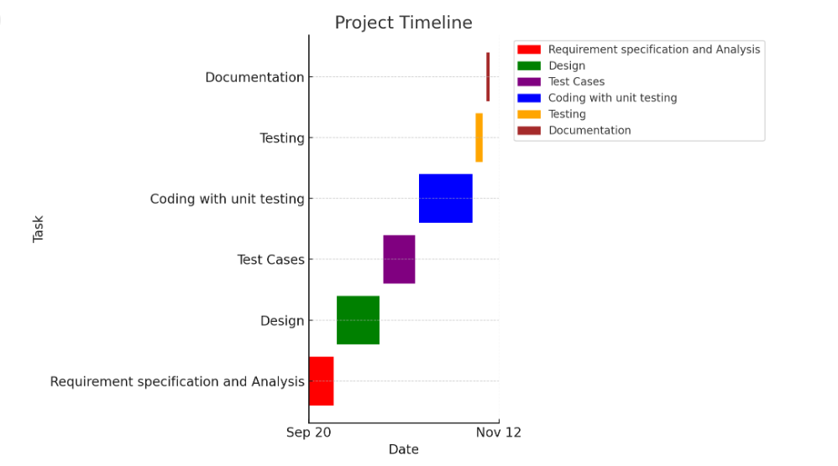
Internship Timeline

Slide 9
Tools and Libraries:
Python: Programming language used for implementing the machine learning pipeline.
YAML: Used for reading configuration settings from a YAML file.
Joblib: Used for saving and loading trained machine learning models efficiently.
Pandas: Used for data manipulation and analysis, particularly for loading and handling datasets.
Scikit-learn: Comprehensive library for machine learning algorithms and model evaluation.
train_test_split: Used for splitting the dataset into training and validation sets.
cross_val_score: Used for performing cross-validation to evaluate the model.
accuracy_score, confusion_matrix, classification_report: Used for evaluating the performance.

Slide 10
Hardware and Software Requirements
Hardware:
CPU: Intel Core i5 or equivalent
RAM: 8GB
Storage: 512TB SSD
Operating System:
Windows 11, macOS, or Linux (Ubuntu)
Software:
Python 3.12
Visual Studio Code

Slide 11
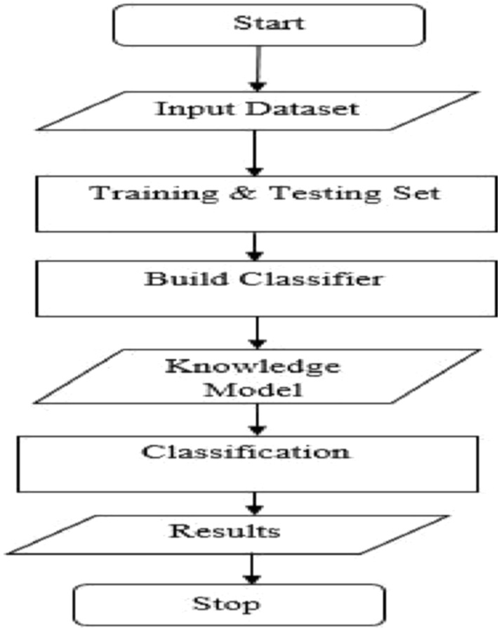
Flow Diagram
Input Dataset:
Collect and input the dataset, which includes various symptoms, patient histories, and other relevant medical information.
Training & Testing Set:
Split the dataset into training and testing sets to create a robust model that can generalize well to new, unseen data.
Build Classifier:
Use machine learning algorithms to build the classifier. For this project, the Naive Bayes algorithm is implemented.
Knowledge Model:
Develop a knowledge model by training the classifier on the training set. This model encapsulates the learned patterns and relationships from the data.
Classification:
Utilize the trained knowledge model to classify new data inputs. This step involves predicting the likelihood of various chronic diseases based on the input symptoms.
Results:
Generate and display the results of the classification. These results indicate the predicted diseases and their corresponding probabilities.

Slide 12
Internship Implementation
Set Up Environment:
Install required libraries (pandas, scikit-learn, seaborn, matplotlib, PyYAML, joblib).
Prepare Config File:
Create config.yaml for configuration settings.
Data Collection and Preprocessing:
Collect dataset, clean data, and perform feature selection.
Split Dataset:
Use train_test_split to divide data into training and testing sets.
Train Model:
Initialize and train Naive Bayes classifier.
Save the trained model using joblib.
Evaluate Model:
Validate on the validation set
Test Model:
Load saved model and predict on the test set.
Deployment:
Develop an application for user input and disease prediction.

Slide 13
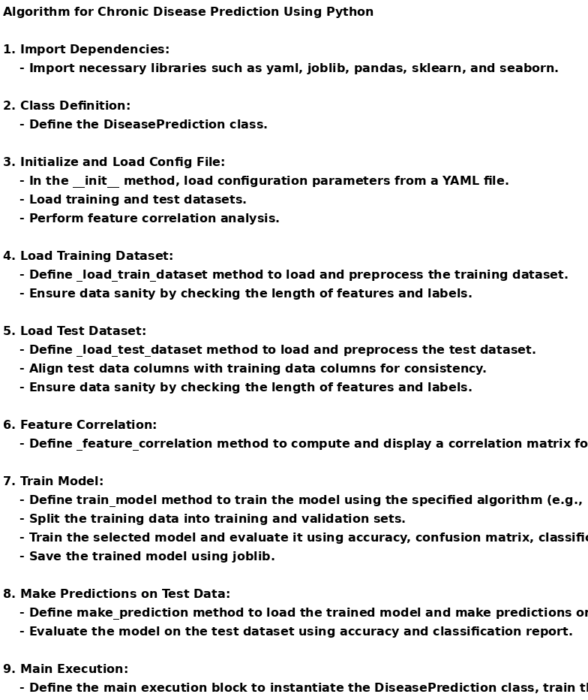
Algorithm:

Slide 14
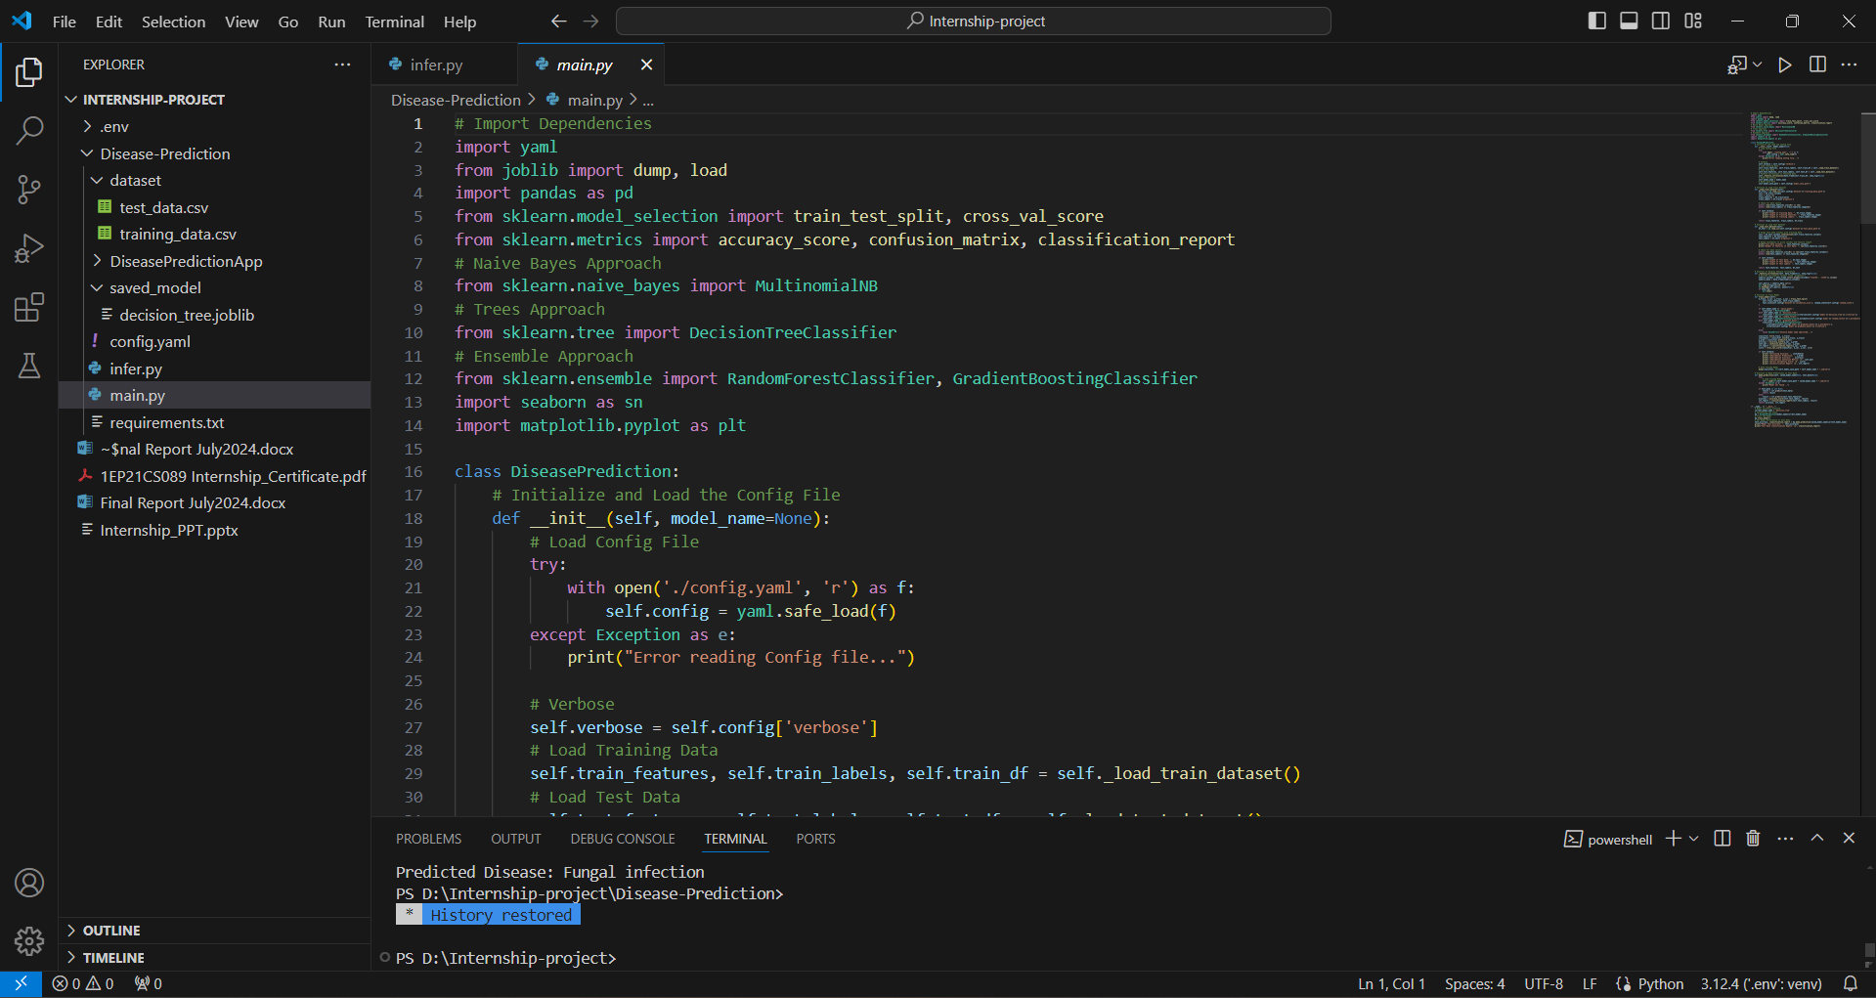
Sample Code

Slide 15
Learning Outcomes
Data Preprocessing and Feature Selection:
Gained proficiency in cleaning and preparing datasets for machine learning, including handling missing values
and selecting relevant features.
Model Training and Evaluation:
Learned to implement and evaluate machine learning models, particularly the Naive Bayes classifier,
and understand key performance metrics like accuracy, precision, recall, and F1 score.
Model Deployment:
Acquired skills in saving trained models and deploying them in real-world applications for user-friendly predictions.
Visualization and Interpretation:
Developed the ability to visualize data correlations and model performance using libraries like Seaborn and
Matplotlib for better interpretation and communication of results.
Continuous Improvement:
Understood the importance of a feedback loop in machine learning projects to collect new data, retrain models,
and continuously improve prediction accuracy.

Slide 16
Challenges Faced
Feature Selection and Dimensionality Reduction: With a large number of symptoms the dataset can become very high-dimensional. Naive Bayes relies on the assumption that features are independent, which might not hold true in practice. This can lead to poor performance if there's significant correlation among symptoms. You may need to employ feature selection techniques or dimensionality reduction methods (like PCA) to improve the algorithm's effectiveness.
Handling Imbalanced Data: Chronic disease datasets often have imbalanced classes, meaning that some diseases may be much less common than others. This imbalance can cause the Naive Bayes algorithm to be biased towards the more frequent classes, leading to poor performance in predicting less common diseases. Techniques like resampling, using synthetic data generation (SMOTE), or applying different weighting schemes for classes can help address this challenge.

Slide 17
References
Smith, J., Brown, A., “Chronic Disease Prediction Using Machine Learning Techniques,” Journal Name, Year, Volume, pp. 135–137.
Johnson, M., White, L., Chronic Disease Prediction: Methods and Applications, 3rd ed., Publisher, Publisher Location, Country, 2015, pp. 154–196.
Davis, K., Martinez, R., “A Comprehensive Review on Chronic Disease Prediction Models,” International Journal of Healthcare Informatics, Year, Volume, pp. 45–67.
Patel, S., Lee, C., “Implementing AI for Chronic Disease Prediction,” Journal of Medical Systems, Year, Volume, pp. 98–112.
Thompson, G., “Predictive Analytics in Healthcare: Chronic Disease Management,” Journal of Health Research, Year, Volume, pp. 220–234.
Walker, P., Hernandez, D., “Big Data Approaches for Chronic Disease Prediction,” Data Science Journal, Year, Volume, pp. 300–315.

Slide 18
THANK YOU

